Slide 1
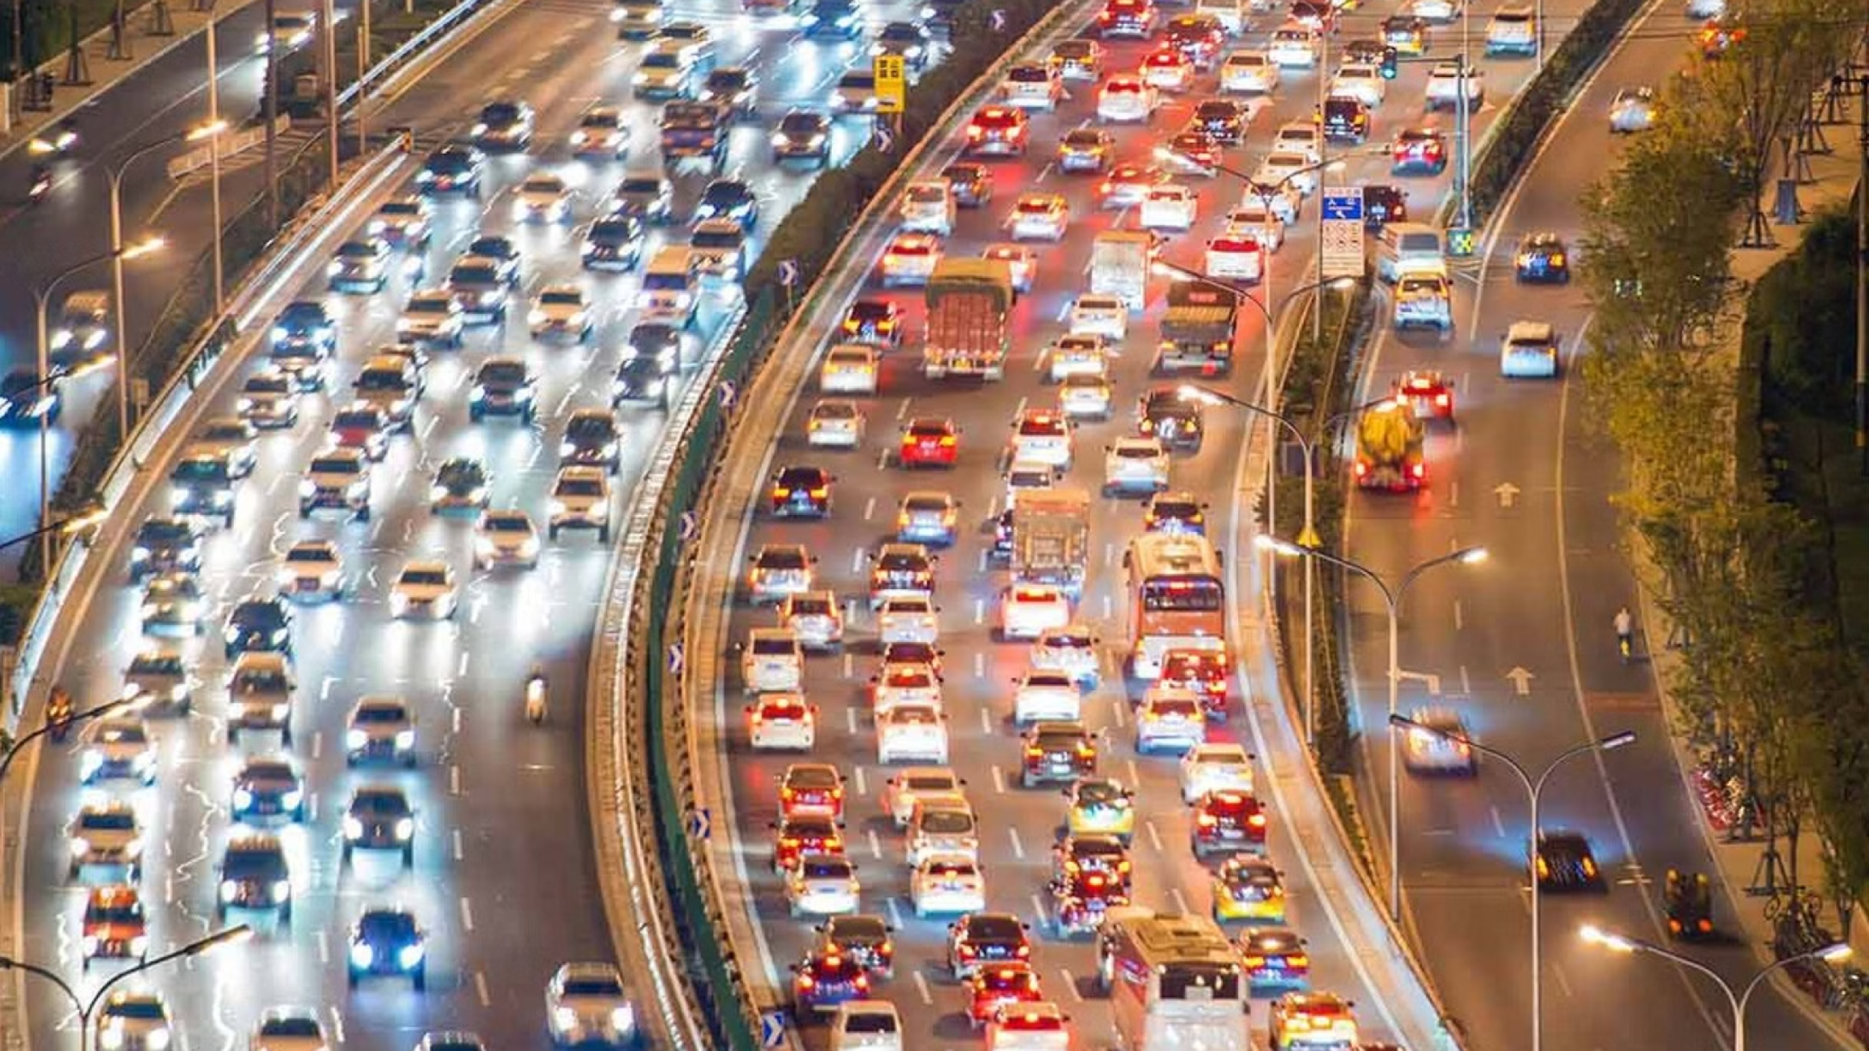
HONS. ML INTERNAL ASSESSMENT
Identifying and Analyzing Traffic Congestion Patterns in Urban Environments
Unsupervised & Supervised Approaches to Smart City Traffic Analysis
by:
Aaryan Sharma: 16010123012
Aryan Raut: 16010123080
Tanmay Chinchore: 16010123135

Slide 2
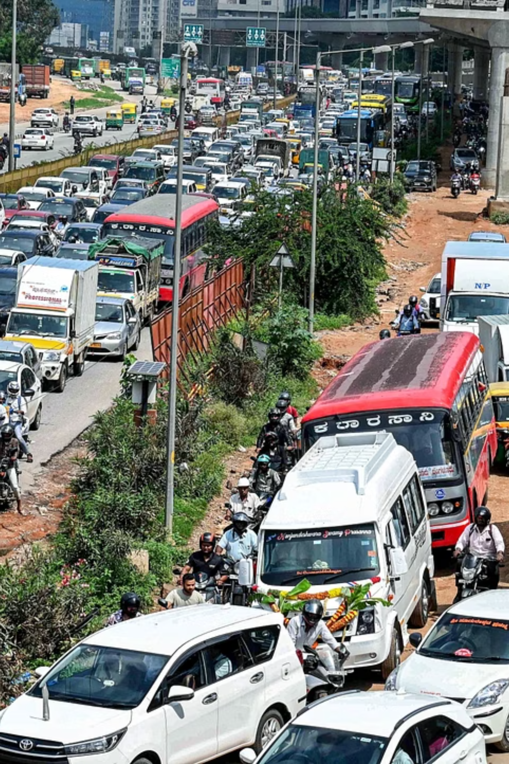
Problem Statement & Objective
The Problem
Our Objective
Urban traffic congestion creates unpredictable, high-stress patterns — causing severe delays and driver frustration across city networks.
Apply a data-driven ML pipeline to identify and analyze traffic congestion patterns using both unsupervised and supervised learning.
Our Approach
Clustering groups traffic states into meaningful patterns. Regression then predicts the Driver Stress Index to pinpoint root causes.

Slide 3
The Dataset & Preprocessing
Smart City Traffic Stress Dataset
Data Preparation Steps
50,000 instances capturing real-world urban traffic scenarios across diverse conditions.
Missing Value Removal
One-Hot Encoding
Key Variables
Rows with null entries were dropped to ensure clean training data.
pd.get_dummies() converted categorical features like Weather into machine-readable binary columns.
Traffic Density, Average Speed, Signal Wait Time
Horn Events, Weather, Road Quality, Driver Experience
Target: stress_index (scored 0–100)

Slide 4
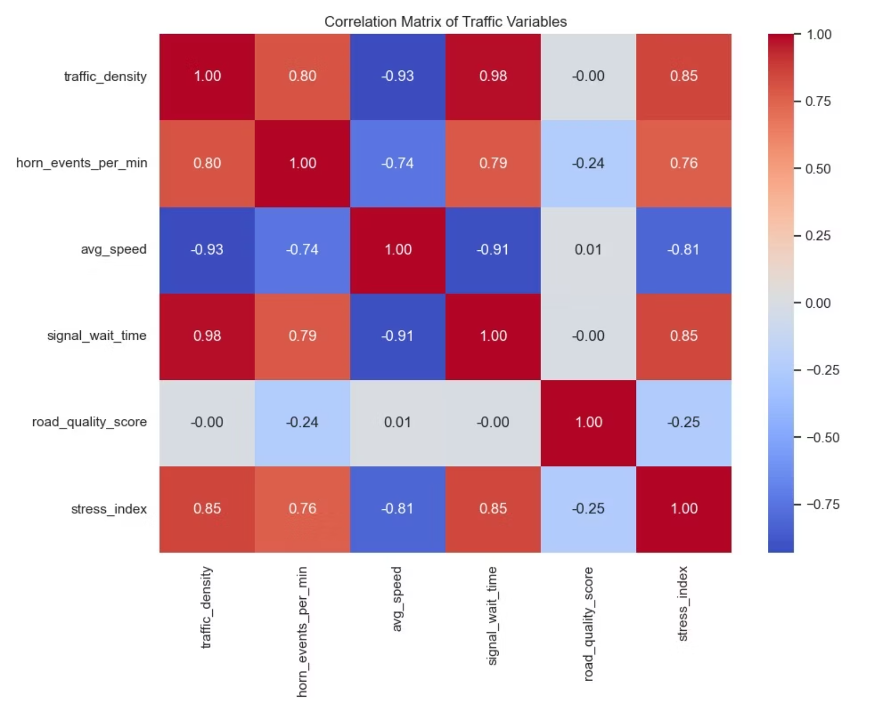

Exploratory Data Analysis
Establishing Variable Interdependence
Key Findings from the Correlation Matrix
Near-Perfect Positive Link
Traffic density vs. signal wait time: +0.98 — volume directly cascades into intersection delays.
Strong Negative Link
Traffic density vs. average speed: −0.93 — congestion predictably suppresses vehicle velocity.
Stress Drivers
stress_index correlates strongly with density (+0.85) and signal wait (+0.85) — time lost equals frustration.

Slide 5
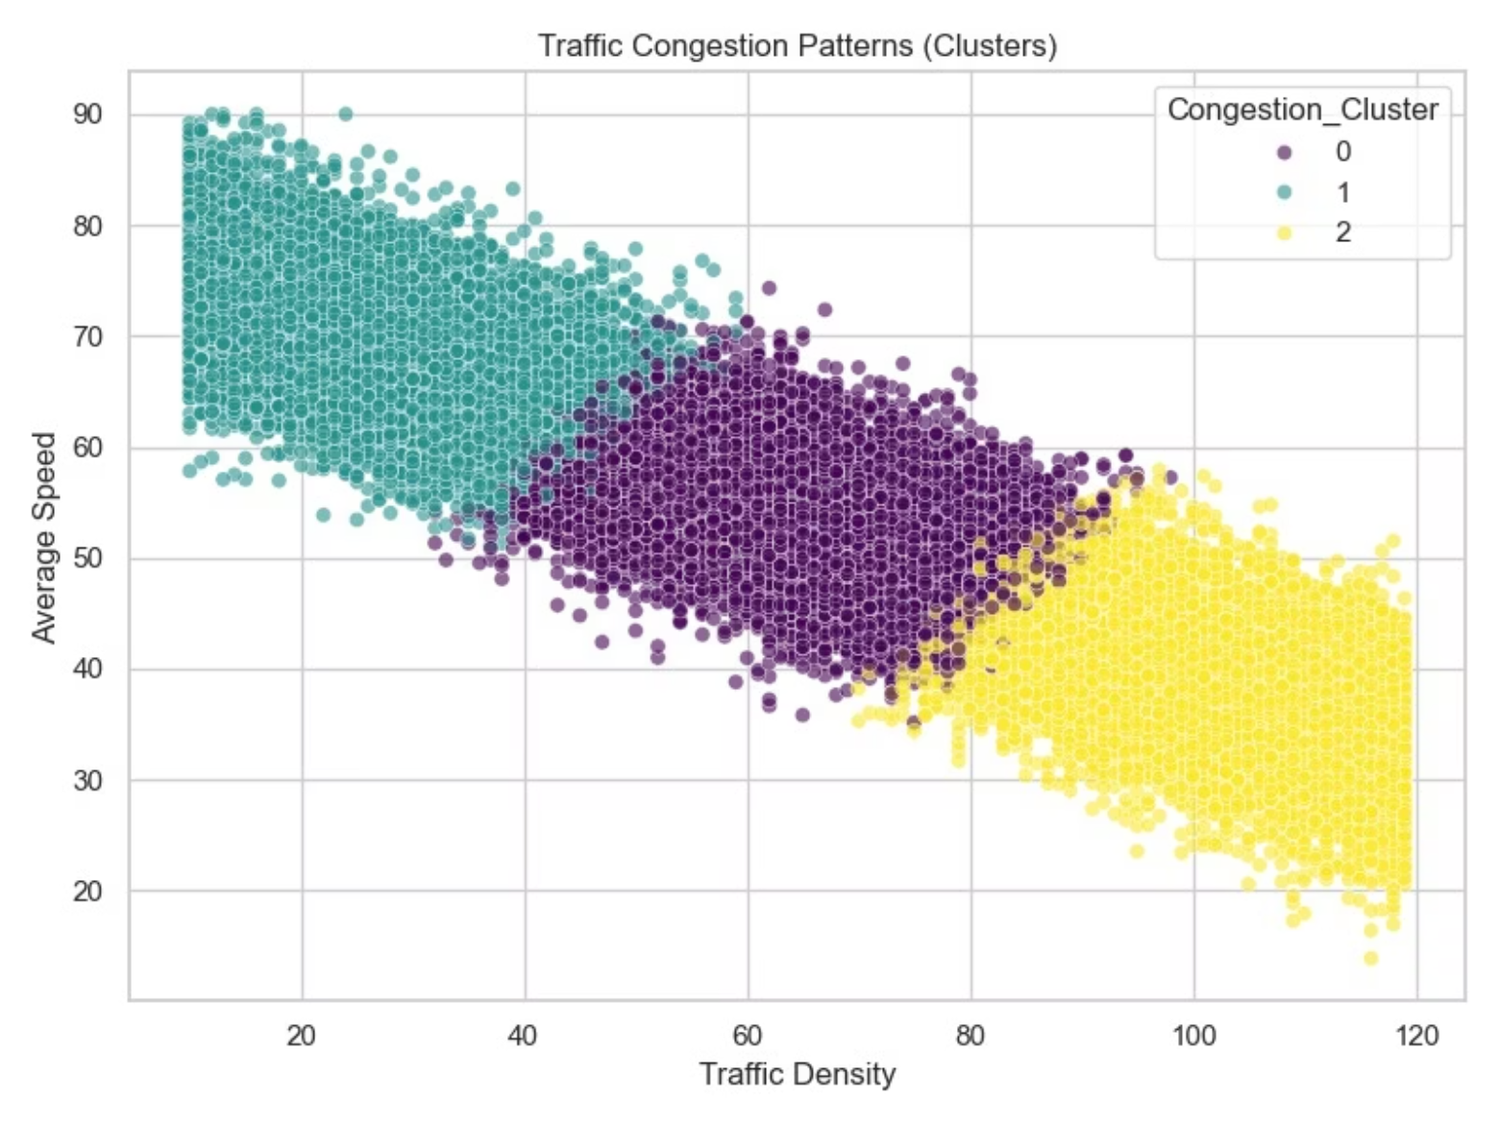
Identifying Patterns — Unsupervised Learning
Discovering 3 Core Congestion States via K-Means Clustering
🟢 Cluster 1 — Free Flowing
🟣 Cluster 0 — Moderate Constraints
Low density (<40) · High speeds (60–90+ km/h) · Minimal driver stress.
Medium density (40–80) · Moderate speeds (40–70 km/h) · Growing friction.
🟡 Cluster 2 — Severe Congestion
High density (80–120) · Very low speeds (down to 20 km/h) · Peak stress zone.

Slide 6
Predicting Traffic Stress — Supervised Learning
Modeling the Stress Index with Random Forest Regression
Why Random Forest?
Model Design
Traffic behavior is inherently non-linear — weather and density interact in unpredictable ways. A single decision tree would overfit; an ensemble of trees generalizes robustly.
Algorithm: Random Forest Regressor
Target: Continuous stress_index (0–100)
Strength: Ensemble approach reduces variance and handles outliers gracefully
Input features: All preprocessed traffic and environmental variables

Slide 7

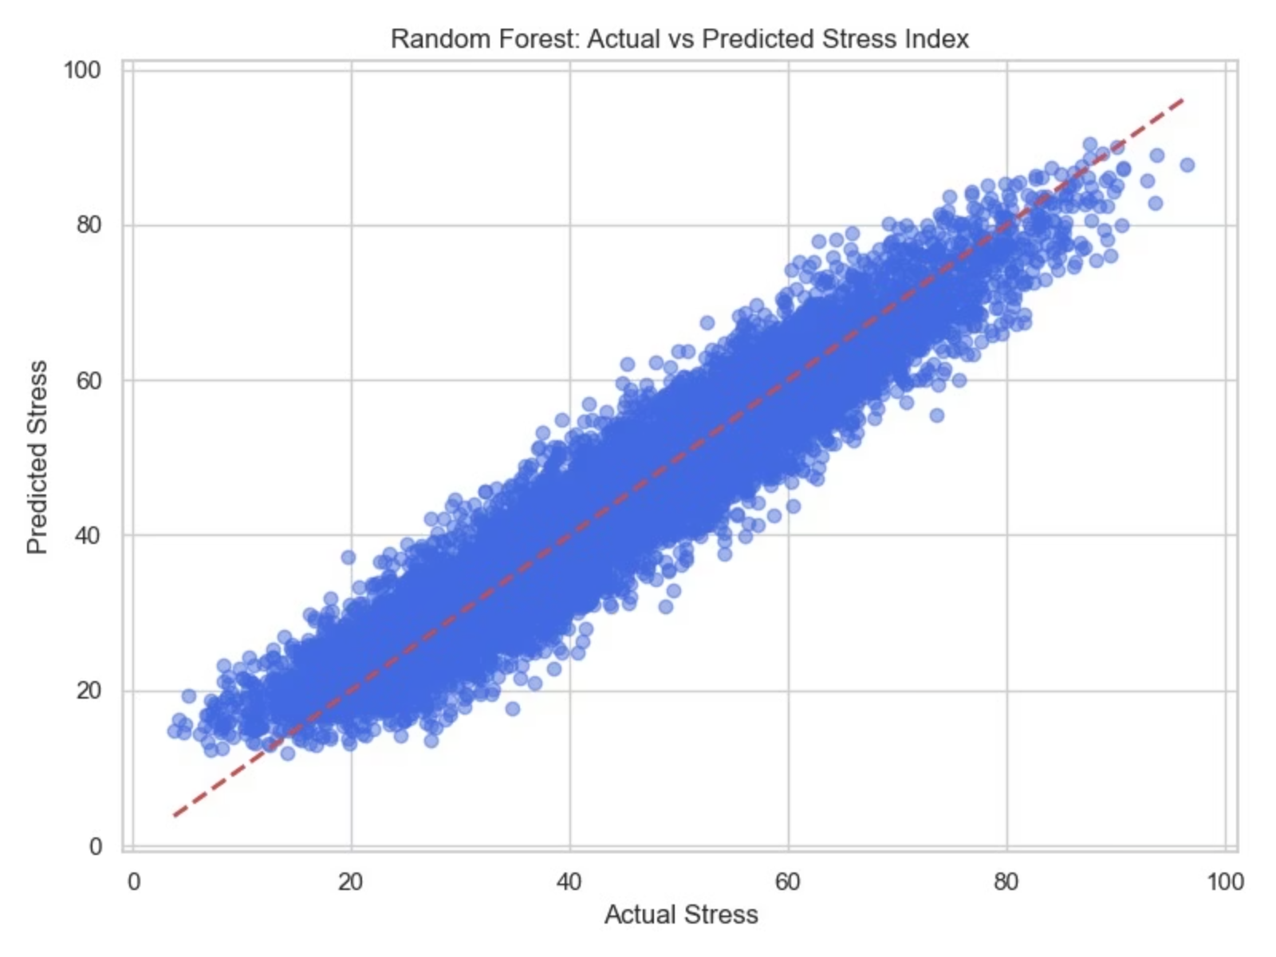
Results at a Glance
Model Evaluation — Prediction Accuracy
Predicted values cluster tightly around the perfect-accuracy reference line, confirming minimal systematic bias. The model generalizes confidently across low, moderate, and severe congestion states.
R² Score
Excellent explanatory power across all traffic conditions

Slide 8
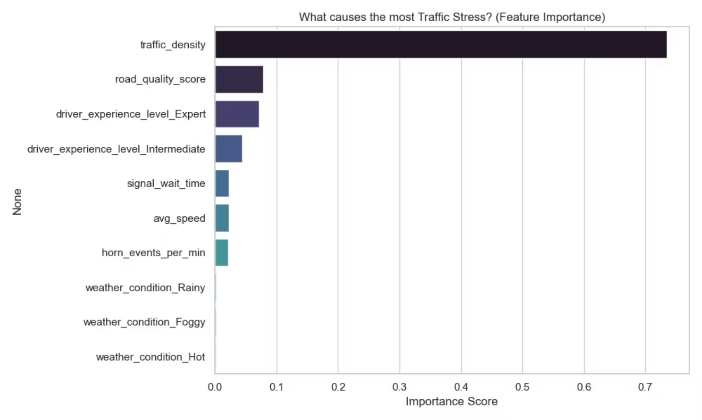
What Drives Traffic Stress?
Feature Importance Analysis — Random Forest
Key Findings
🥇 Traffic Density
The dominant factor — the single greatest trigger of driver stress in urban settings.
🥈 Road Quality & Driver Experience
Ranked as distant second and third — meaningful but secondary contributors to stress levels.
🌧️ Weather — Surprisingly Low
Rainy and foggy conditions had the lowest direct impact on the model's stress predictions.

Slide 9

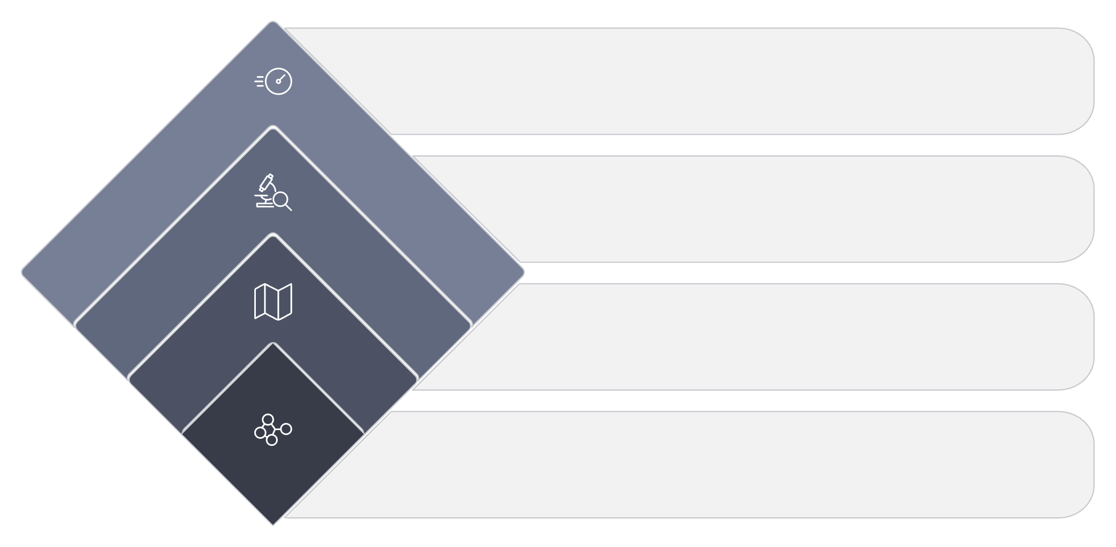




Conclusion & Real-World Impact
What We Achieved
Smart City Deployment
Our dual-model pipeline fully addressed the project objective:
These models could be integrated into smart-city infrastructure to dynamically adjust traffic light timings when a sector enters Cluster 2 (Severe Congestion) — proactively reducing peak-stress conditions before they escalate.
K-Means Clustering visually segmented traffic into 3 interpretable congestion states
Random Forest Regression (R² ≈ 0.90) structurally ranked the root causes of driver stress
Together, they transform raw sensor data into actionable urban insight
Data-driven signal control, powered by ML, is a practical and scalable path toward safer, less stressful urban mobility.
Key Driver
Traffic Density top, R² = 0.90
Phase 2: Analyze
Random Forest ranks drivers
Interpret Patterns
Free Flow, Moderate, Severe
Phase 1: Discover
K-Means finds 3 congestion clusters

